Slide 1
Memory Management : Virtual Memory, Swapping, Paging, Segmentation, Free Space Management, Translation Look Aside Buffer, Demand Paging, Thrashing , Page Replacement Algorithms
Dr. VIJAYA CHANDRA JADALA

Slide 2
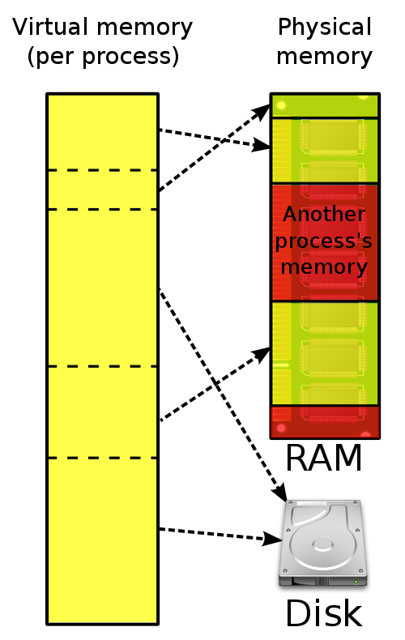
What is Memory Virtualization ?
Virtual Memory is a technique of executing program instructions that may not fit entirely in the system memory.
OS virtualizes its physical memory.
OS provides an illusion memory space per each process.
It seems to be seen like each process uses the whole memory .
Virtual Memory is a technique of executing Program instructions that may not fit entirely in the system memory.

Slide 3
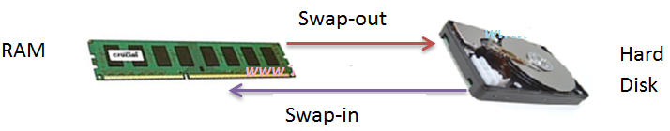
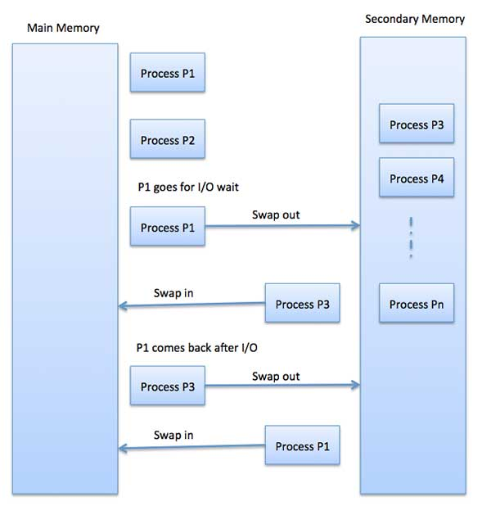
SWAPPING
SWAPPING is the Process of temporarily removing inactive programs from the main memory of a computer system.
Swapping is a mechanism in which a process can be swapped temporarily out of main memory (or move) to secondary storage( Disk) and make that memory available to other processes. At some later time, the system swaps back the process from the secondary storage to main memory.

Slide 4
Segmentation
A Segment can be defined as a logical grouping of Instructions such as a subroutine, array or a data area.
Every Program (job) is a collection of these segments.
Each job is divided into several segments of different sizes, one for each module that contains pieces that perform related functions
Each Segment is actually a different logical address space of the Program
Segmentation is a memory management scheme which supports the programmer’s view of memory. Programmers never think of their programs as a linear array of words. Rather, they think of their programs as a collection of logically related entities such as subroutines or procedures, functions, global or local data areas, stacks etc.,

Slide 5
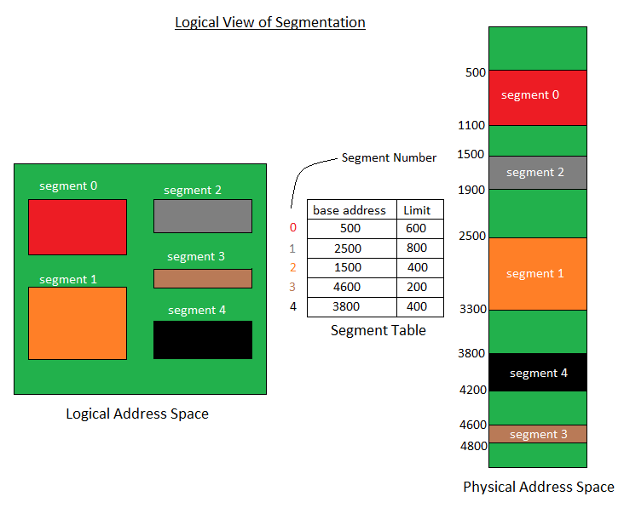
A process is divided into Segments. The chunks that a program is divided into which are not necessarily all the same sizes are called segments. Segmentation gives user’s view of the process which paging does not give. Here the user’s view is mapped to physical memory.
There are types of segmentation:
Virtual memory segmentation – Each process is divided into a number of segments, not all of which are resident at any one point in time.
Simple segmentation – Each process is divided into a number of segments, all of which are loaded into memory at run time, though not necessarily contiguously.
There is no simple relationship between logical addresses and physical addresses in segmentation. A table stores the information about all such segments and is called Segment Table.
Segment Table – It maps two-dimensional Logical address into one-dimensional Physical address. It’s each table entry has:
Base Address: It contains the starting physical address where the segments reside in memory.
Limit: It specifies the length of the segment.

Slide 6
Advantages of Segmentation –
No Internal fragmentation.
Segment Table consumes less space in comparison to Page table in paging.
Disadvantage of Segmentation –
As processes are loaded and removed from the memory, the free memory space is broken into little pieces, causing External fragmentation.

Slide 7
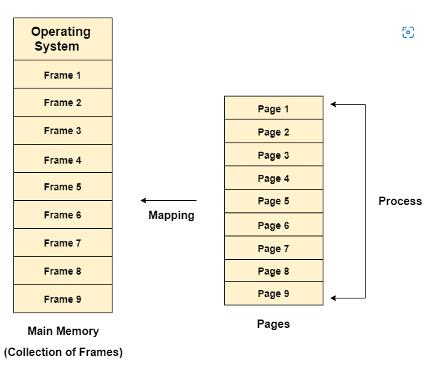
Paging
Paging splits up address space into fixed-sized unit called a page.
With paging, physical memory is also split into some number of pages called a page frame.
Page table per process is needed to translate the virtual address to physical address.

Slide 8
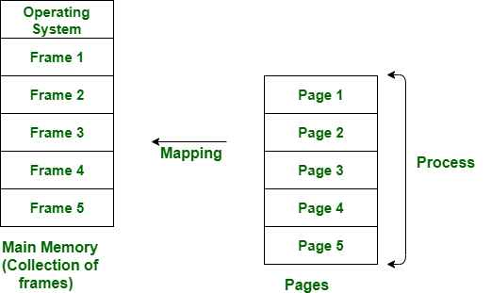
Paging
Paging is a storage mechanism used to retrieve processes from the secondary storage into the main memory in the form of pages.
The main idea behind the paging is to divide each process in the form of pages. The main memory will also be divided in the form of frames.

Slide 9
Advantages Of Paging
Easy to use memory management algorithm
No need for external Fragmentation
Swapping is easy between equal-sized pages and page frames
Allocating memory is easy and cheap
Dis-Advantages Of Paging
May cause Internal fragmentation
Page tables consume additional memory.
Multi-level paging may lead to memory reference overhead.

Slide 10
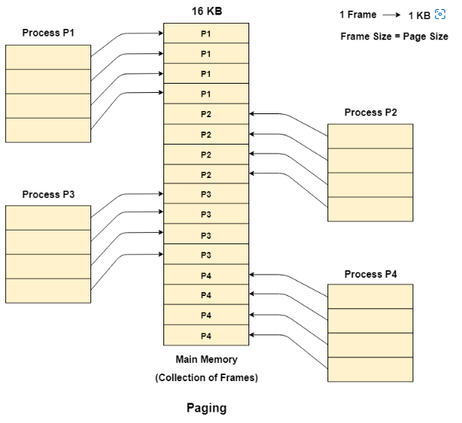

Slide 11
Example: A Simple Paging
128-byte physical memory with 16 bytes page frames
64-byte address space with 16 bytes pages
0
page frame 0 of physical memory
reserved for OS
16
(unused)
page frame 1
0
32
(page 0 of the address space)
page 3 of AS
page frame 2
16
48
(page 1)
page 0 of AS
page frame 3
32
64
(page 2)
(unused)
page frame 4
48
(page 3)
80
page 2 of AS
page frame 5
64
A Simple 64-byte Address Space
96
(unused)
page frame 6
112
page 1 of AS
page frame 7
128
64-Byte Address Space Placed In Physical Memory

Slide 12
Address Translation
Two components in the virtual address
VPN: virtual page number
Offset: offset within the page
Example: virtual address 21 in 64-byte address space
VPN
offset
Va5
Va4
Va3
Va2
Va1
Va0
VPN
offset
0
1
0
1
0
1

Slide 13
Example: Address Translation
The virtual address 21 in 64-byte address space
VPN
offset
Virtual
Address
0
1
0
1
0
1
Address Translation
Physical
Address
1
1
1
0
1
0
1
PFN
offset

Slide 14
Paging
Segmentation
In Paging Scheme, the main memory is partitioned into frames(or blocks).
The logical address space is divided into pages by the compiler or memory management unit (MMU)
This Scheme suffer from internal Fragmentation or Page Breaks.
The OS maintains a free frame list; there is no need to search for free frame.
In Segmentation scheme, the main memory is partitioned into segments.
The logical address space is divided into segments as specified by the programmer.
This scheme suffers from external fragmentation.
The OS maintains the particulars of available memory.

Slide 15
Paging
Segmentation
The Operating System maintains a Page map Table for mapping between frames and pages.
This scheme does not support the users view of memory
Processor uses the page number and displacement to calculate absolute address (p, d)
The Operating System maintains a segment map table for mapping purpose.
This scheme supports user view of memory
Processor uses the segment number and displacement to calculate the absolute address (s, d)

Slide 16
Demand Paging
It is scheme in which a page is not loaded into the main memory from the secondary memory, until it is needed.
So, in demand paging, pages are loaded only on demand and not in advance.
The advantage here is that now lesser I/O is needed, less memory is needed, faster response and more users serviced now.

Slide 17
Pure Demand Paging
Pure Demand paging is the form of demand paging in which not even a single page is loaded into memory initially.
Therefore, the very first instance instruction cause a page fault in this case.
This type of demand paging may significantly decrease the performance of a computer system by generally increasing the effective access time of memory.

Slide 18
Performance of Demand Paging
1. Page fault rate, p, is given as – 0 <= p <= 1.0
That is if P = 0 then no page faults
If P = 1 then every reference is a fault
2. Effective Access Time (EAT) is given as follows –
EAT = (1-p) * memory access + p(page fault overhead) + (Swap page out) + (swap page in ) + (Restart overhead)
Performance of Pure Demand Paging
EAT = (1-P) * m1 + p * page-fault time

Slide 19
Translation Look Aside Buffer
A translation lookaside buffer (TLB) is a memory cache that stores recent translations of virtual memory to physical addresses for faster retrieval.
When a virtual memory address is referenced by a program, the search starts in the CPU. First, instruction caches are checked.
If the required memory is not in these very fast caches, the system has to look up the memory’s physical address.
At this point, TLB is checked for a quick reference to the location in physical memory.

Slide 20
TLB
Part of the chip’s memory-management unit(MMU).
A hardware cache of popular virtual-to-physical address translation.
Logical
Address
TLB
Lookup
MMU
TLB Hit
Physical
Address
TLB
popular v to p
TLB Miss
CPU
Page Table
all v to p entries
Page 0
Page 1
Page 2
…
Page n
Address Translation with MMU
Physical Memory
Notes:
말그대로 파풀러한 애들을 캐시해주는 거니까 그림이 잘못됬음.

Slide 21
Translation Look Aside Buffer
When an address is searched in the TLB and not found, the physical memory must be searched with a memory page crawl operation.
As virtual memory addresses are translated, values referenced are added to TLB.
When a value can be retrieved from TLB, speed is enhanced because the memory address is stored in the TLB on processor.
Most processors include TLBs to increase the speed of virtual memory operations through the inherent latency-reducing proximity as well as the high-running frequencies of current CPU’s.

Slide 22
Translation Look Aside Buffer
TLBs also add the support required for multi-user computers to keep memory separate, by having a user and a supervisor mode as well as using permissions on read and write bits to enable sharing.
TLBs can suffer performance issues from multitasking and code errors. This performance degradation is called a cache thrash.
Cache thrash is caused by an ongoing computer activity that fails to progress due to excessive use of resources or conflicts in the caching system.

Slide 23
Free Space Management
A file system is responsible to allocate the free blocks to the file therefore it has to keep track of all the free blocks present in the disk. There are mainly two approaches by using which, the free blocks in the disk are managed.
1. Bit Vector
In this approach, the free space list is implemented as a bit map vector. It contains the number of bits where each bit represents each block.
If the block is empty then the bit is 1 otherwise it is 0. Initially all the blocks are empty therefore each bit in the bit map vector contains 1.
As the space allocation proceeds, the file system starts allocating blocks to the files and setting the respective bit to 0.
2. Linked List
It is another approach for free space management. This approach suggests linking together all the free blocks and keeping a pointer in the cache which points to the first free block.
Therefore, all the free blocks on the disks will be linked together with a pointer. Whenever a block gets allocated, its previous free block will be linked to its next free block.

Slide 24
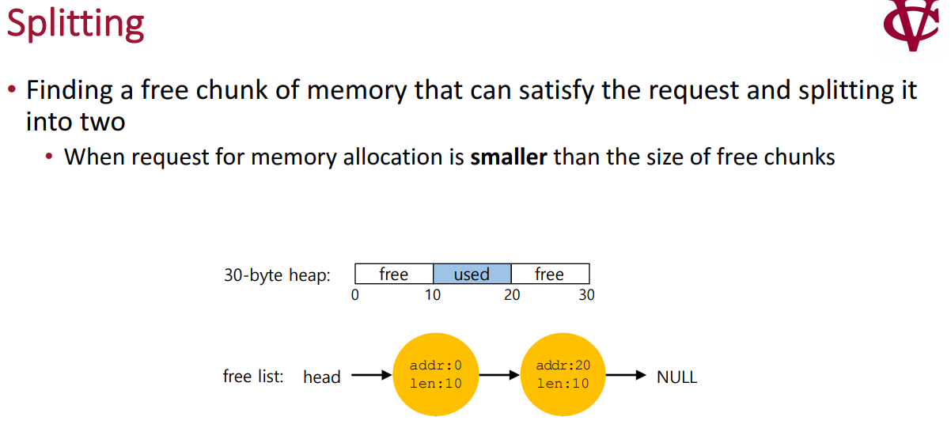

Slide 25
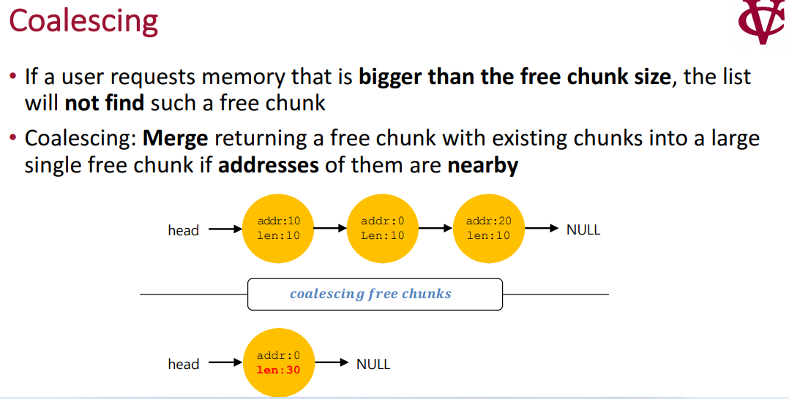

Slide 26
Free Space With Chunks Allocated
size: 100
[virtual address: 16KB]
8 bytes header
magic: 1234567
■ ■ ■
100 bytes still allocated
size: 100
sptr
magic: 1234567
■ ■ ■
100 bytes still allocated
(but about to be freed)
size: 100
magic: 1234567
■ ■ ■
100 bytes still allocated
head
size: 3764
next: 0
■ ■ ■
The free 3764-byte chunk
Free Space With Three Chunks Allocated

Slide 27
Free Space With free()
Example: free(sptr)
[virtual address: 16KB]
size: 100
magic: 1234567
The 100 bytes chunks is back into the free list.
The free list will start with a small chunk.
The list header will point the small chunk
The free() function is used to deallocate memory while it is allocated using malloc(), calloc() and realloc(). The syntax of the free is simple. We simply use free with the pointer. Then it can clean up the memory.
■ ■ ■
100 bytes still allocated
head
size: 100
sptr
next: 16708
(now a free chunk of
memory)
■ ■ ■
size: 100
magic: 1234567
■ ■ ■
100 bytes still allocated
size: 3764
next: 0
■ ■ ■
The free 3764-byte chunk

Slide 28
Thrashing
If the number of frames allocated to a low-priority process falls below the minimum number then we must suspend that process execution.
We should then page out its remaining pages, freeing all its allocated frames.
So, now swapping is required. We can find some process in a system that does not have “enough” frames.
It is technically possible to reduce the number of allocated frames to the minimum, there is some(larger) number of pages in active use.
If the Process does not have this number of frames then it will quickly page fault again and again.
The process continues to fault, replacing pages for which It then faults and brings back in right away. Such a process spend more time in paging than executing.
This high paging activity is called as Trashing. A process is said to be trashing if it is spending more time in paging then in execution.

Slide 29
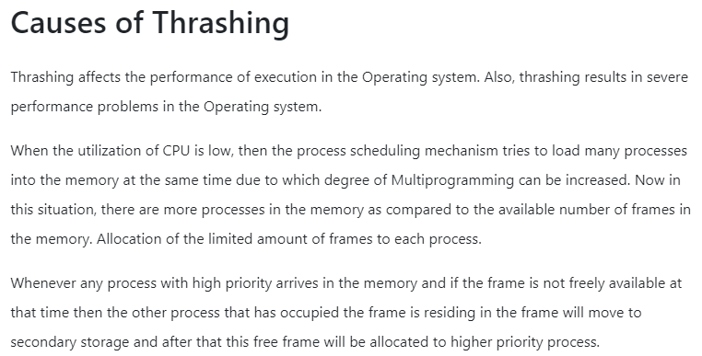

Slide 30
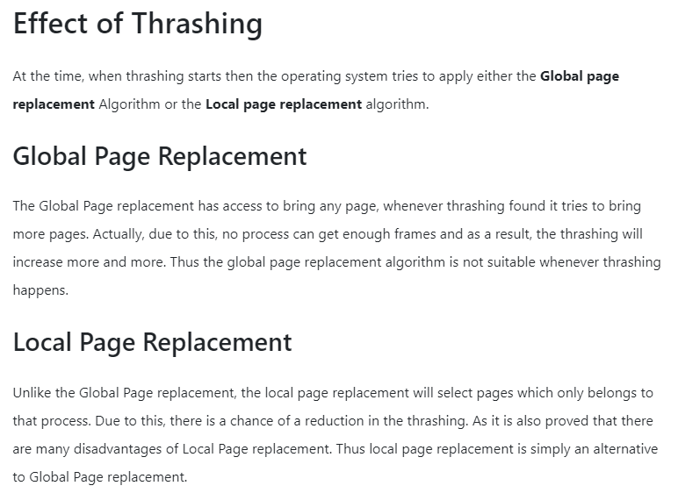
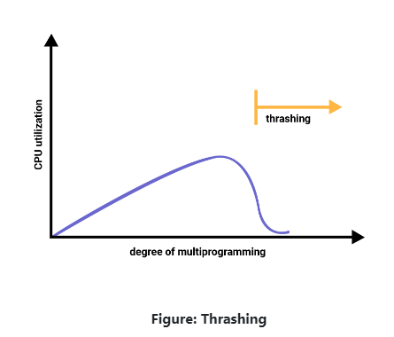

Slide 31

Page Replacement Algorithms – FIFO
FIFO is one of the simplest page replacement algorithms. A FIFO page replacement algorithm associates with each page the time when that page was brought into memory. At the point when a page must be replaced, the most experienced or oldest page is selected.
Consider the following reference string: 0, 2, 1, 6, 4, 0, 1, 0, 3, 1, 2, 1. Using FIFO page replacement algorithm –
So, total number of page faults = 9. Given memory capacity (as number of pages it can hold) and a string representing pages to be referred, write a function to find number of page faults.

Slide 32
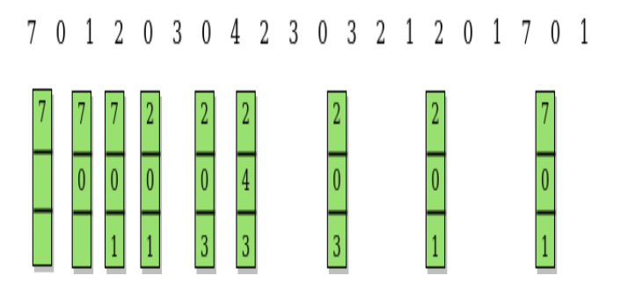
Optimal Page Replacement Algorithm
The Optimal Page Replacement algorithm has the lowest page fault rate of all algorithms. The criteria of this algorithm is “ Replace a page that will not be used for the longest period of time”
(The Longest Time in Feature)

Slide 33
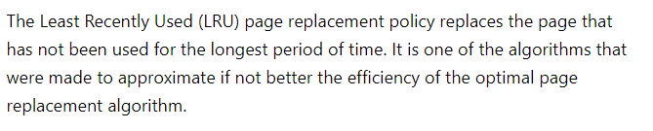
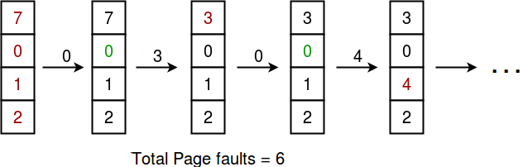
LRU Page Replacement Algorithms
page reference string 7 0 1 2 0 3 0 4 2 3 0 3 2 and Frame set is 4

Slide 34
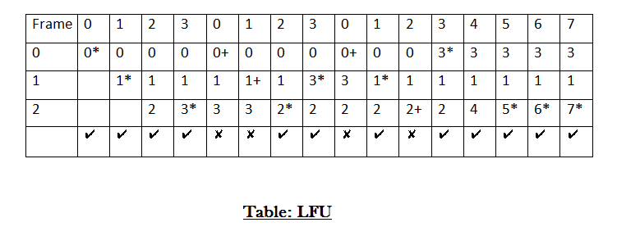
Least Frequently Used Page Replacement Algorithms – LFU
The Least Frequently used algorithm “Selects a page for replacement, if the page has not been used often in the past” or “Replace page that page has smallest count”

Slide 35
Most Frequently Used Page Replacement Algorithms – MFU
The Most Frequently used algorithm “Selects a page for replacement, if the page has been used often in the past” or “Replace page that page has highest count”

Slide 36
Belady’s Anomaly
Belady’s Anomaly is the phenomenon of increasing the number of page faults on increasing the number of frames in main memory. “Algorithms suffer from Belady’s Anomaly” does not mean that always the number of page faults will increase on increasing the number of frames in main memory. This unusual behavior is observed only sometimes.

